Slide 1
Investigating the intricacies of Schizophrenia-like Disorders: A Synthetic Data Analysis
[YOUR NAME]

Slide 2
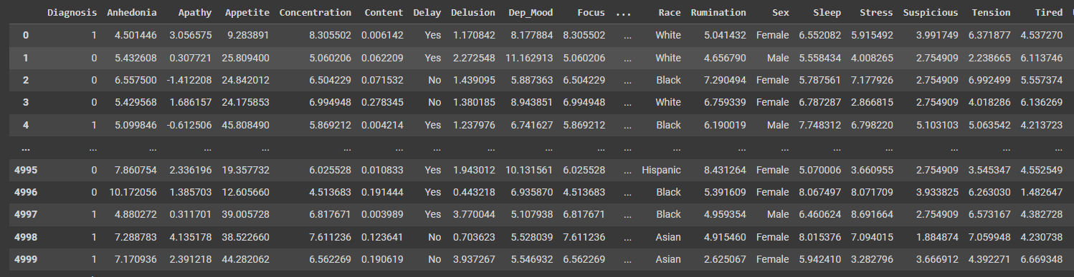
Introduction
The objective of this study is to examine the application of machine learning algorithms in understanding a simulated schizophrenia-like condition. Utilizing a synthetic data set consisting of 5,000 individuals with diverse lifestyle and symptom characteristics, the research aims to uncover patterns and insights that can shed light on the complexities of mental health disorders.

Slide 3
Objectives
Preprocessing the dataset and perform exploratory data analysis (EDA)
Unsupervised Machine Learning Analysis: Clustering and Dimensionality Reduction
Supervised Machine Learning Analysis for Classifying and Predicting in a Schizophrenia-like Illness Dataset

Slide 4
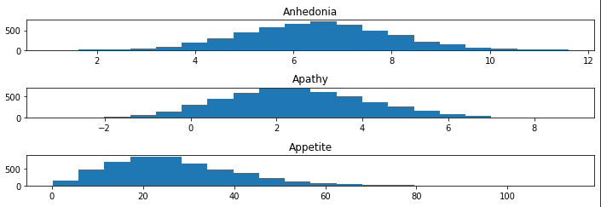
Overview of the data
The objective of this project is to examine the potential of machine learning techniques in comprehending a simulated form of schizophrenia. The study will utilize a synthetic dataset comprising of 5,000 subjects, each with a comprehensive set of demographic and symptom data. The data has been preprocessed to address missing, duplicated and anomalous values, as well as undergoing feature engineering and categorical feature encoding to enhance its applicability for analysis

Slide 5
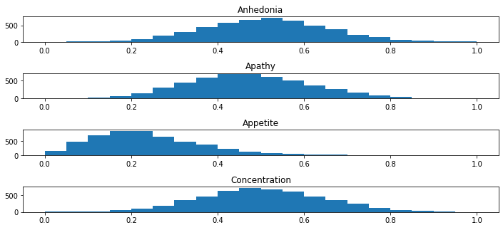
Feature engineering techniques
During the feature engineering phase, a combination of feature extraction and selection techniques were utilized. Initial steps involved the extraction of new features through feature scaling, one-hot encoding, and the creation of dummy variables. Subsequently, relevant features were selected using correlation analysis and mutual information methods to reduce the dimensionality of the dataset and enhance the performance of the models.

Slide 6
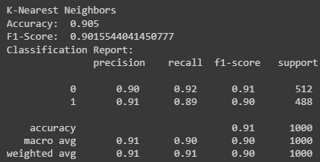
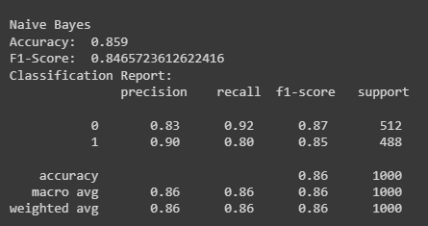
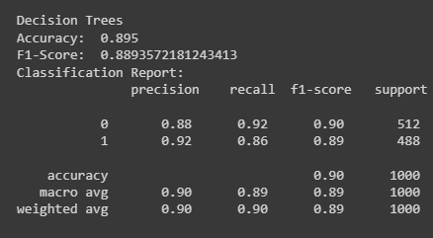
Supervised models used & results
Supervised models built: K-Nearest Neighbors, Naive Bayes, and Decision Trees. Evaluation metrics used: accuracy and F1-Score. Checked for bias using confusion matrix and classification report. Overall, The K-Nearest Neighbors algorithm has the highest accuracy and F1-score among the three models..

Slide 7
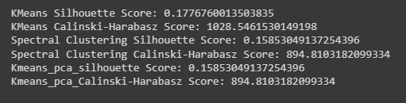
Unsupervised models used & results
We built unsupervised learning models KMeans cluster (KMeans), Mean Shift Clustering, and Spectral Clustering, and dimensionality reduction techniques such as PCA to reduce the number of features. We evaluated the models using metrics such as silhouette score and calinski-harabasz score. Our analysis revealed that the K-means model with dimensionality reduction achieved the best performance in terms of clustering the data.

Slide 8
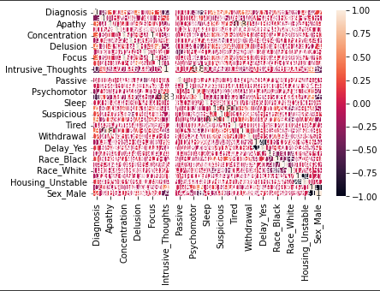
Insights during analysis
In the course of the analysis, several valuable insights were uncovered, including potential biases present in the dataset and the significance of addressing them during the model construction phase. Additionally, the effectiveness of certain feature engineering techniques was identified, as well as the utility of various unsupervised learning methods in gaining a more comprehensive understanding of the data.

Slide 9
Conclusion
In conclusion, our study of the synthetic "schizophrenia-like illness" dataset revealed a number of important findings. By conducting pre-processing, exploratory data analysis, and feature engineering, we were able to gain a deeper understanding of the underlying trends and relationships within the data. Our supervised learning models demonstrated impressive accuracy and F1-scores, with little evidence of bias. Our unsupervised models provided additional insights through clustering and dimensionality reduction.

